Slide 1
Comparative Analysis of MySQL and MongoDB in a High-Concurrency Ticketing System: A Practical Implementation Study

Slide 2
Objectives
Research objectives
Analyze and compare MySQL and MongoDB in transactional behavior, schema design, and nested data management via a ticketing system simulation.
Research Questions
How does MySQL ensure transactional integrity under high concurrency?
How does MongoDB handle concurrent transactions with its flexible schema?
Key differences in transactional operations and data modeling between the two databases.

Slide 3
Methodology overview
Technical infrastructure
Analysis Methods
Validation
Testing

Slide 4
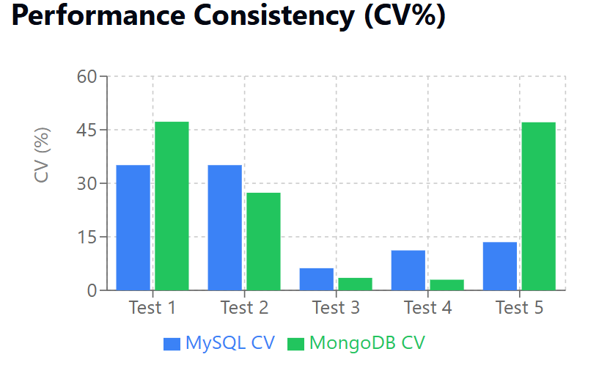
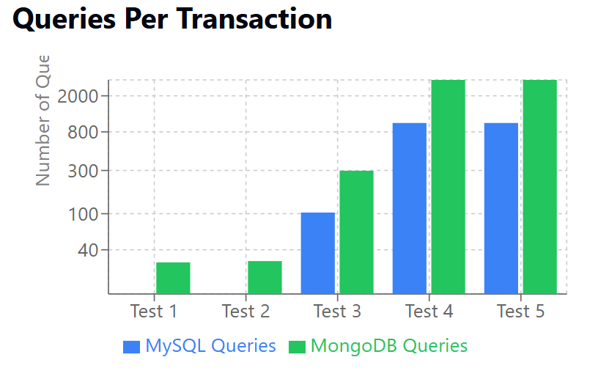
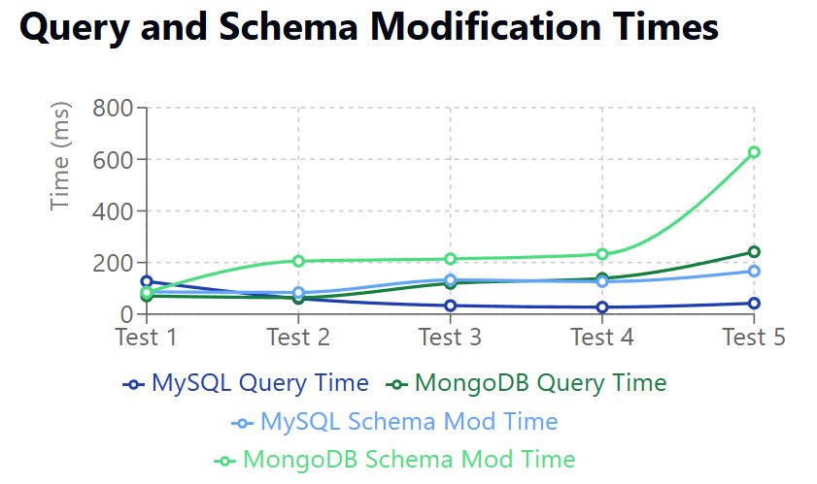
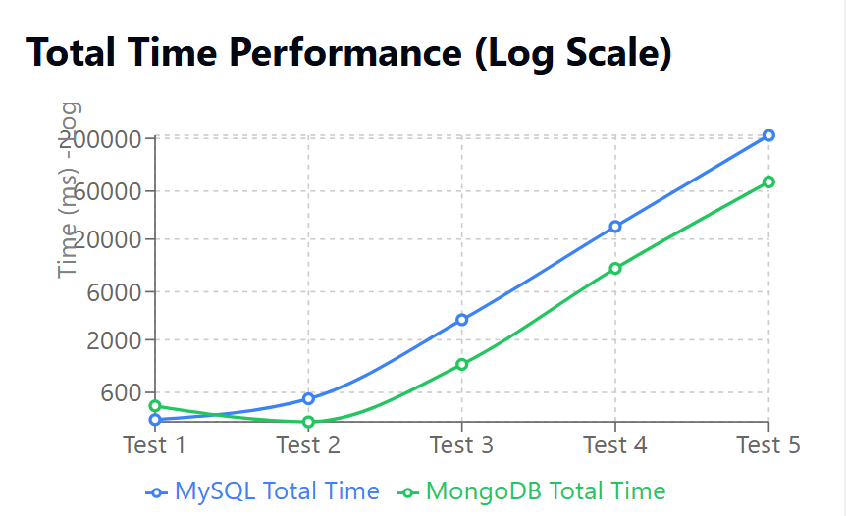

Slide 5
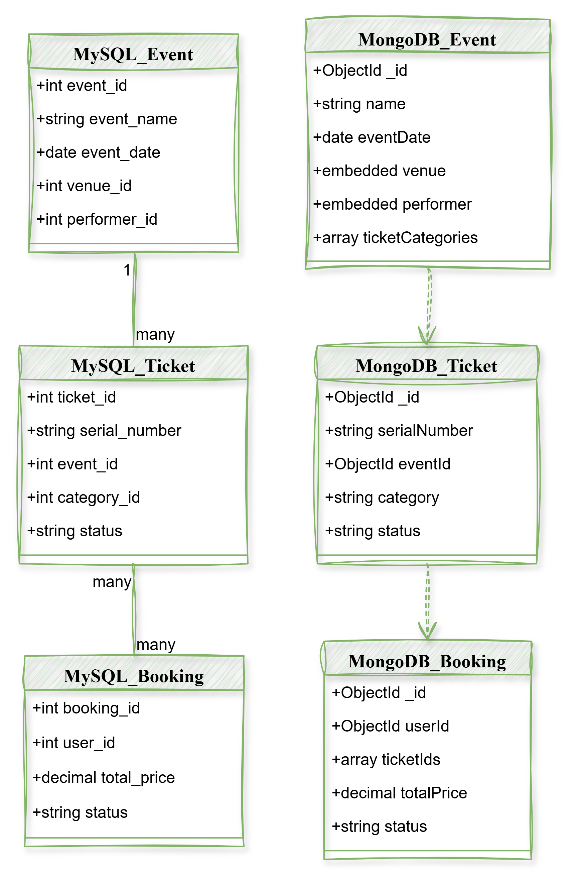
Discussion
Key findings
Connect to research questions
COMPARISON WITH STUDIES
implications

Slide 6

Conclusions
Answers to research questions
Contributions
Recommendations
LIMITATIONS

Slide 7

Future research
Replication strategies comparison
Integration patterns exploration
ORM vs ODM analysis

